Slide 1
Notes:
Last time, Hank has already introduced the part 1-6 of BBCube, and this time I’ll start with section 7 of this paper

Slide 2
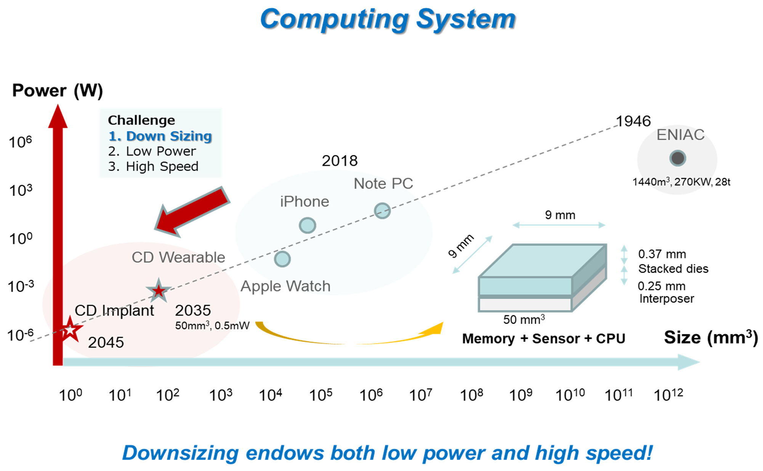
BBCube Memory
Three key challenges of computing systems: Size reduction, reduced power, higher speed.
In 2035, the target device volume will be 50 mm3 with a power consumption of 0.5 mW.
Such a device might be something similar to an AI robotic bee, with CPU/GPU, DRAM , NAND flash memory , and sensors.
Computing system roadmap for the power consumtion as a function of system volume.
Notes:
First is the BBCube memory, we know that there are three key challenges of computing systems, size reduction, reduced power, and higher speed.
size reduction is the most imperative challenge, because both low power and high speed can be achieved by size reduction itself.
And this graph shows the computing system roadmap. In 2035.
We can see that the device volume will be 50 millimetre with power consumption of 0.5 mW.
Such a device might be something similar to an AI robotic bee, with CPU/GPU, DRAM [79], NAND flash memory and sensors which would serve human users, so that the AI robotic bee could observe the users’ surroundings, protect them, and serve as an administrative secretary.

Slide 3
BBCube DRAM
TSVs with micro-bumps are conventionally used for the high-bandwidth memory (HBM) .
Difficult for even HBM to catch up with the increasing speed of GPUs or CPUs
GPU/CPU vendors are constantly striving to increase the speed of their products, for example, to 2 TB/s and 4 TB/s, focusing on AI systems.
HBM will have to increase the I/O pin speed by 2.5 times, such as the 5.0 Gb/s/pin from the 2.0 Gb/s/pin , and therefore, power and heat will also be increased.
Notes:
To achive the small size and lower power, here we indroduce the BBCube dram
Tradictionally tsvs are usually used for the high-bandwidth memory, however there are some problems when using the micro-bumps.
First is that it’s difficult for even HBM to catch up with the increasing speed of GPUs or CPUs and the vendors of GPU/CPU vendors constantly increase the speed to 2 Terabyte.
It means that HBM will have to increase the I/O pin speed by 2.5 times, such as the 5.0 Gb/s/pin from the 2.0 Gb/s/pin , and therefore, power and heat will also be increased.
Therefore, bbcube provide another solution to solve the problem.

Slide 4
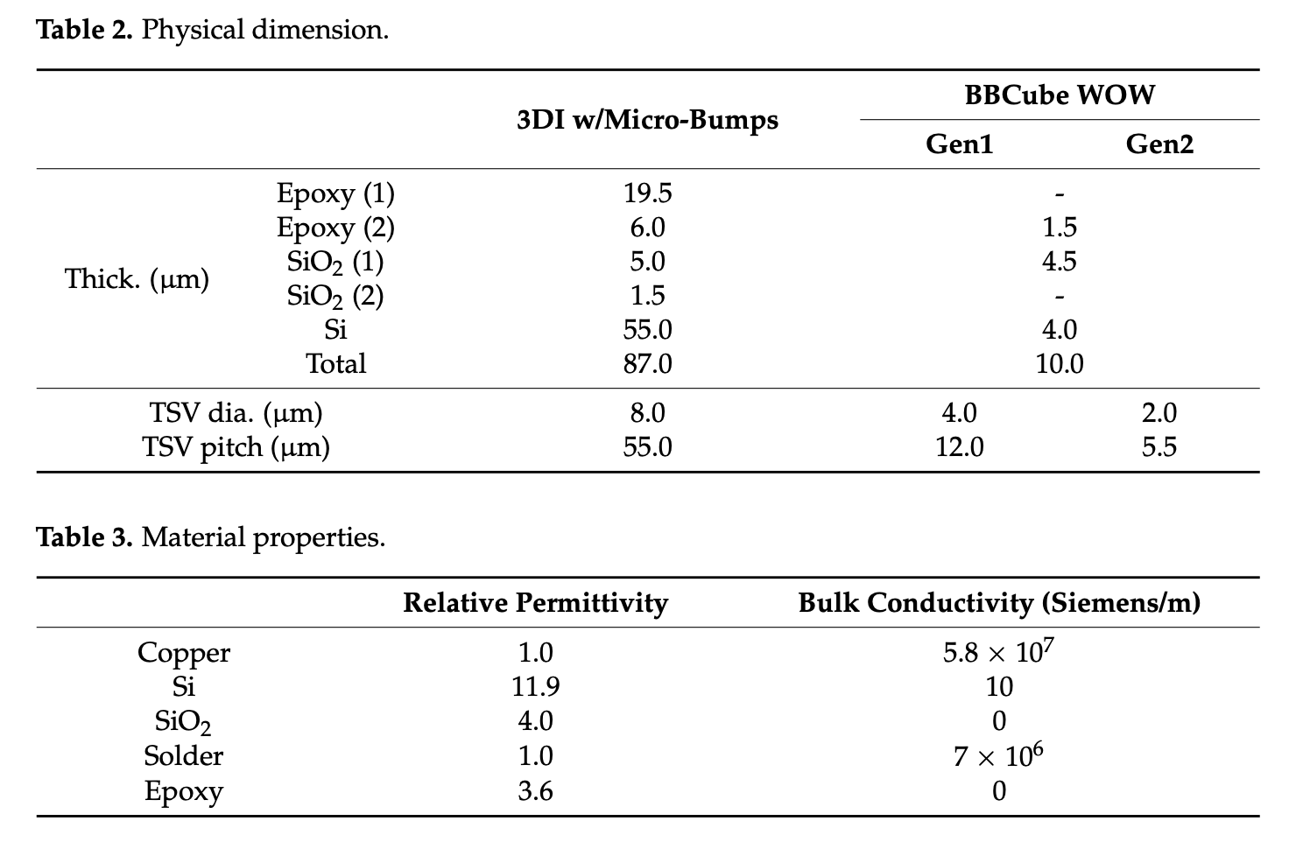
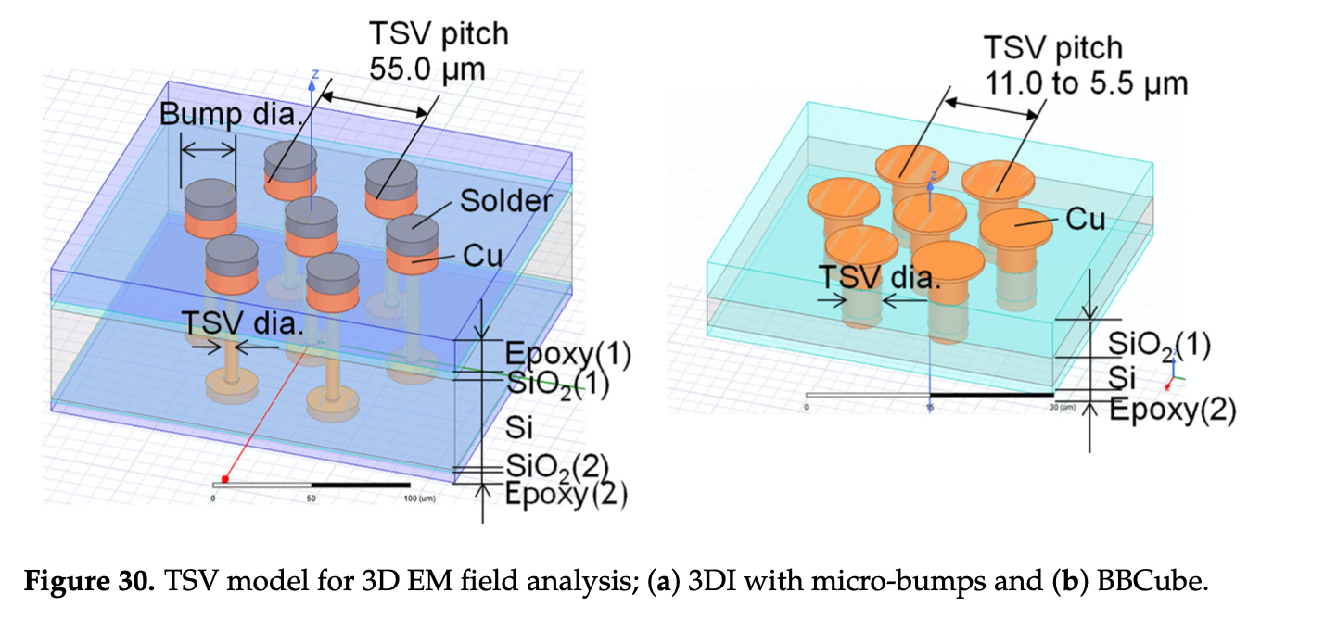
BBCube DRAM (1/) Electrical Characteristics of BBCube
In conventional 3DI, on top of the TSVs, bumps consisting of copper pillars and solder were formed.
Notes:
Here shows the electical charatersitics of BBCube.
We could first see the figure, left is the 3DI with micro—umps and right is BBCube which has no interconnection with bubmps.
Assumed that the dimensions equivalent to those of HBM. We could see the stack pitch of BBCube is

Slide 5
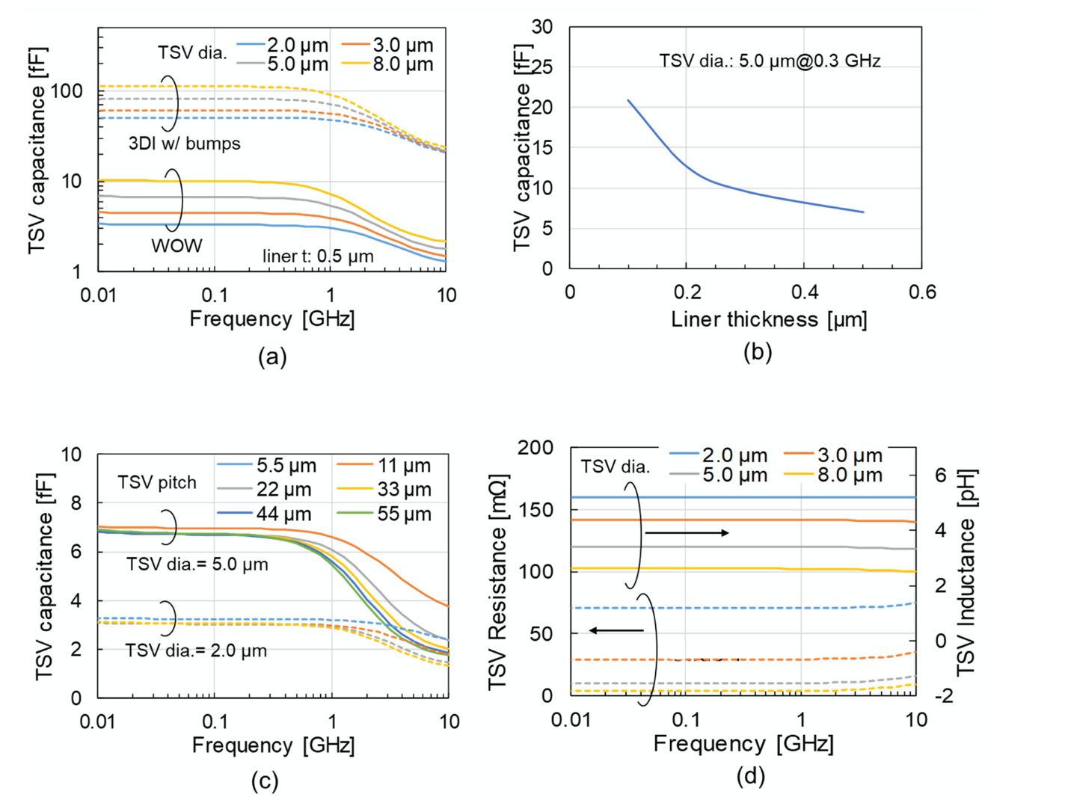

Slide 6
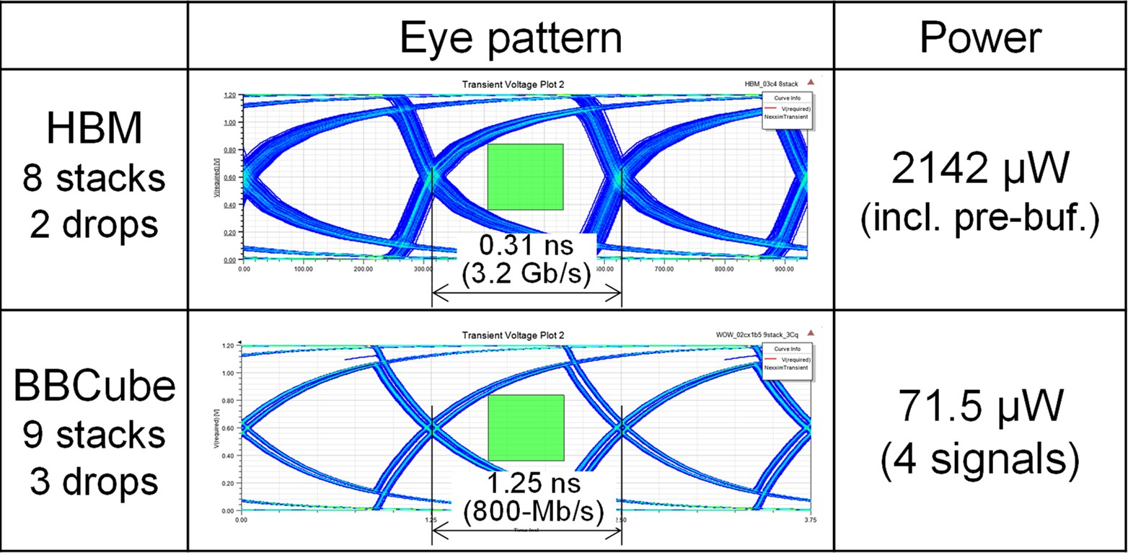
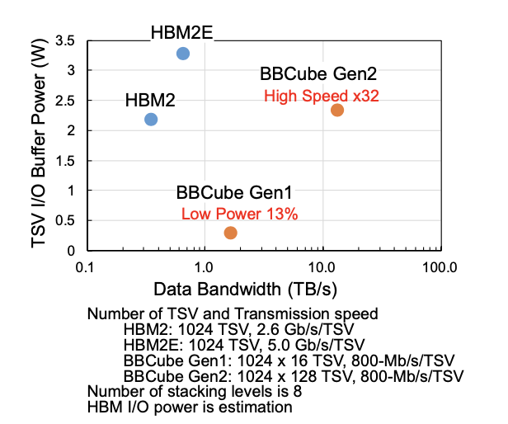
By utilizing the capabilities of the dense TSVs, the data rate was set at only 800 Mb/s, which is lower than the HBM2E of 3.2 Gb/s.
Nine DRAM die was stacked in case of BBCube. An additional die was used to implement novel 3D-based redundancy.
BBCube achieved 30-times higher I/O power efficiency which four-times higher bandwidth with only 13% of the I/O power consumption compared to HBM.
The TSV area in the DRAM die became 64% using 12 µm pitch, and the I/O circuit area becomes about 1/30th.
the next generation (Gen2) should be able to achieve 32-times higher bandwidth with the same I/O power consumption as HBM.

Slide 7
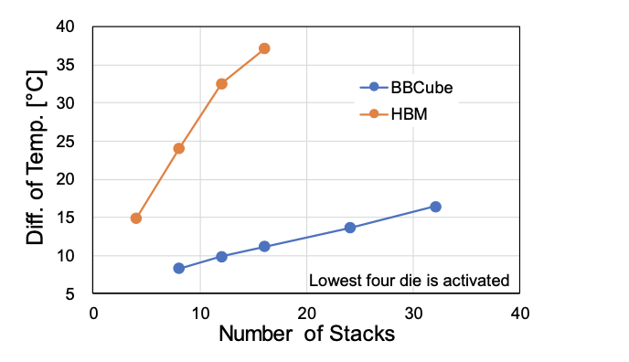
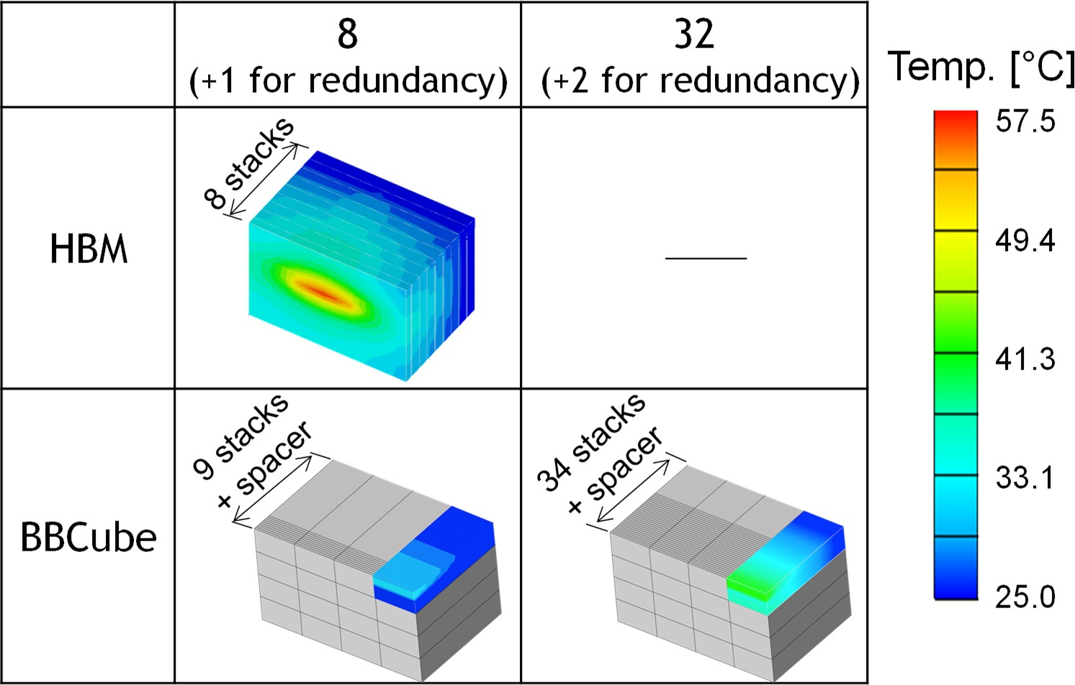
Thermal Characteristics of BBCube
The TSVs in the BBCube were connected directly to the bottom die, whereas with conventional 3DI, it is necessary to put a solder and a BEOL layer between the TSVs, which increases the thermal resistance.
The thermal resistance in the BBCube case which TSVs in the BBCube were connected directly to the bottom die, was 1/4th that of conventional 3DI which had additional solder and a BEOL layer .
The graph shows the temperature difference between the top of the stacked DRAM, which was at room temperature, and the highest temperature part of the DRAM cell with the same power consumption
Even when 34 dies were stacked, the difference in temperature in BBCube was 16 ◦C, which was about two-thirds that of HBM with 8 stacks.
BBCube allowed stacking of 4-times more dies than HBM, and allowed the memory capacity to reach 64 GB using 16 Gb DRAM dies.

Slide 8
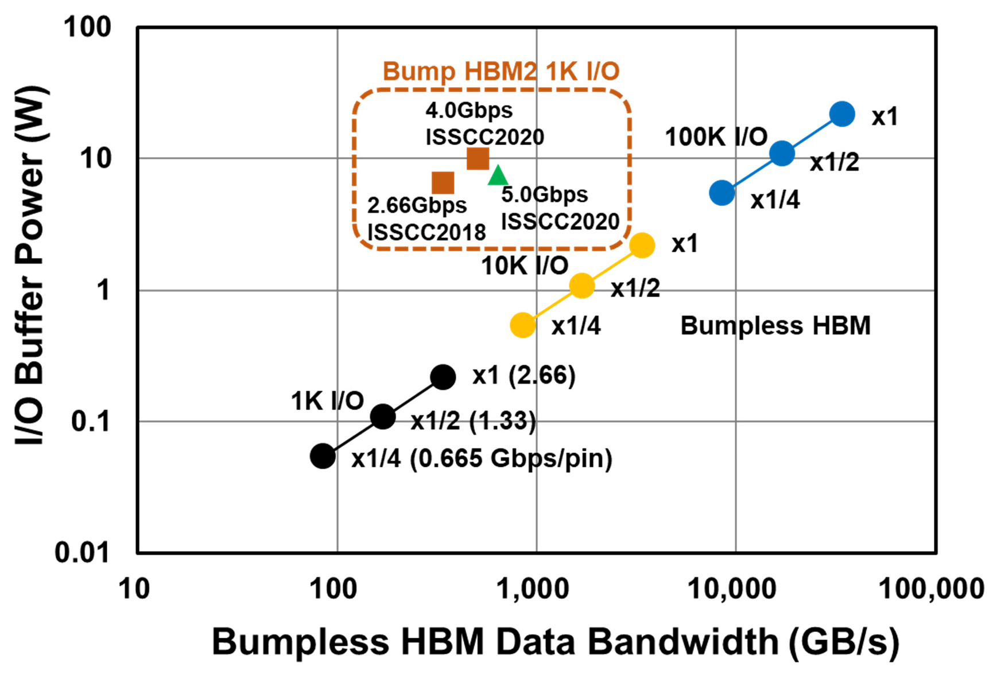
Competitive BBCube DRAM Structure
Bumpless HBM can achieve an ultra-high data bandwidth by increasing the I/O number to 1 K, 10 K and 100 K, and can lower the I/O buffer power to 1/2 or 1/4 by reducing the I/O pin frequency with a four-phase shielded I/O scheme

Slide 9
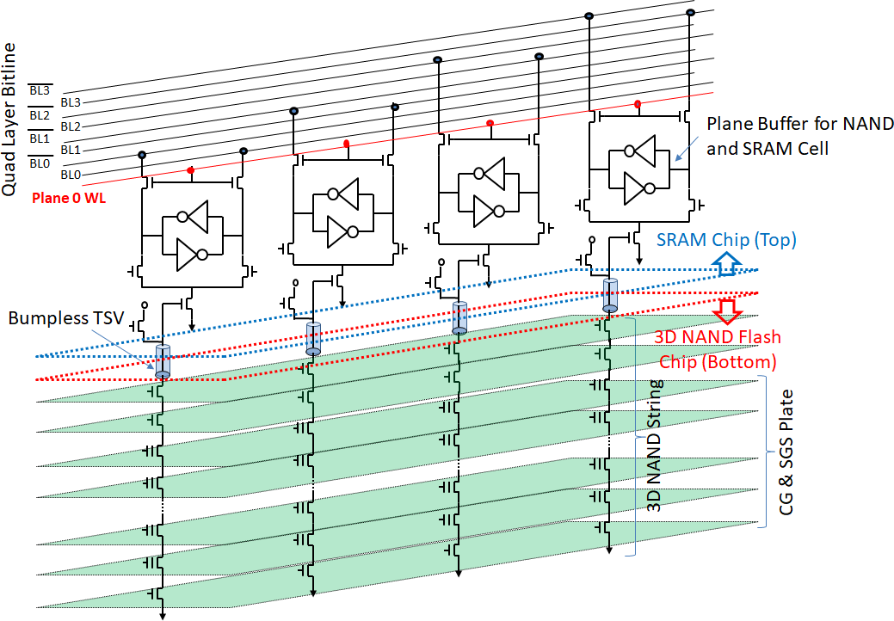
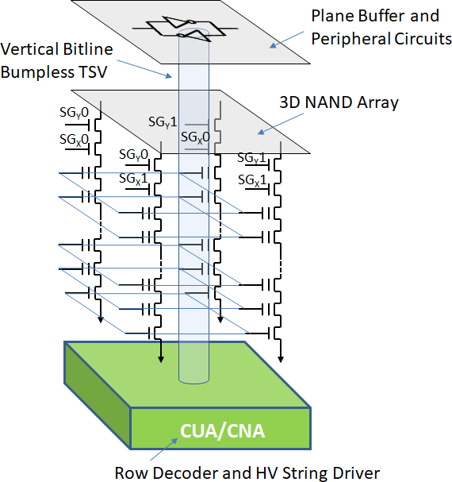
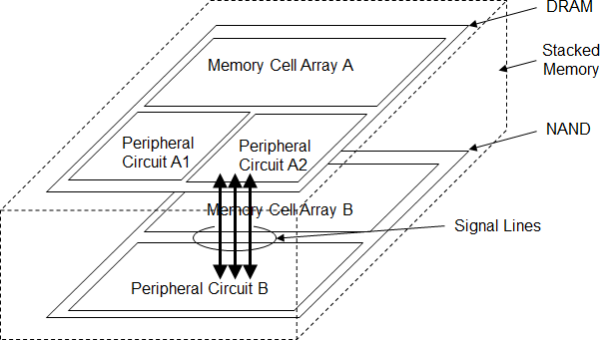
BBCube NAND
Bumpless HBM can achieve an ultra-high data bandwidth by increasing the I/O number to 1 K, 10 K and 100 K, and can lower the I/O buffer power to 1/2 or 1/4 by reducing the I/O pin frequency with a four-phase shielded I/O scheme

Slide 10
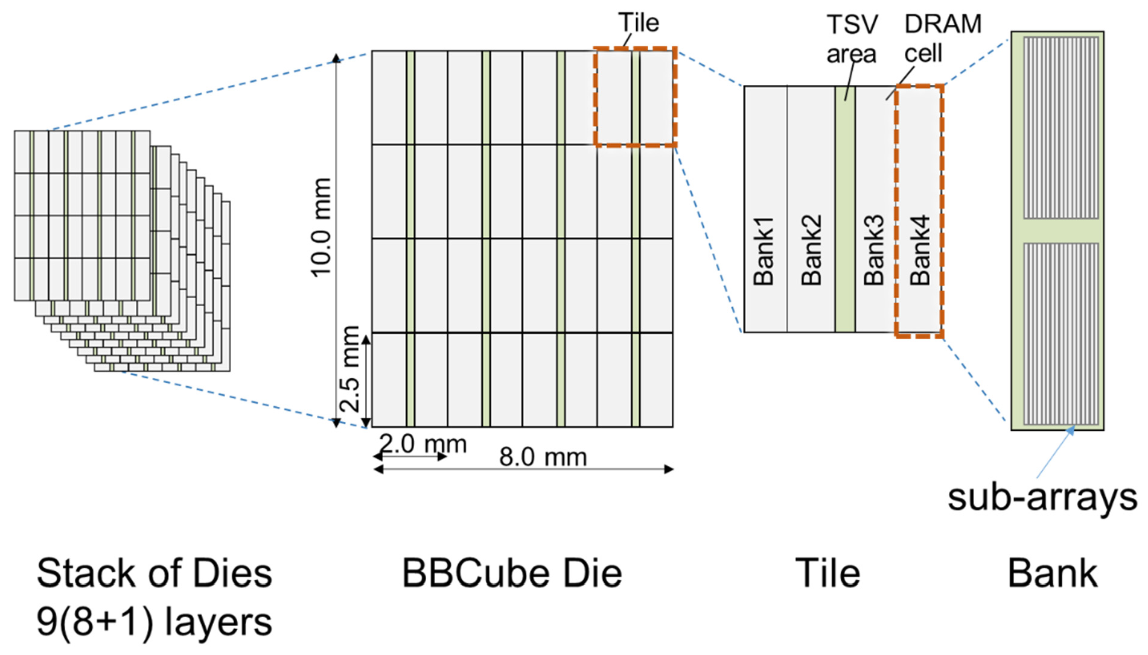
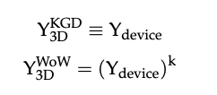
BBCube 3D redundancy – Introduction to 3D redundancy
Wafer form fabrication is the key to utilizing these techniques, and to enjoying the benefits of the maturity of manufacturing equipment.
Each die is equipped with 16 tiles, and each tile has 4 or more banks.
These tiles are memory arrays with 1024 I/Os vertically connected by TSVs. Therefore, massively high parallelism of 16 k I/Os was realized.
each bank, sub-arrays of DRAM cells with extra sub-arrays are provided to perform intra die redundancy of a layer-by-layer scheme. We called this two-dimensional (2D) redundancy.
the stacked device yield of the KGD process, YKGD, was equal to the wafer test yield, Y3D , was calculated from the wafer test yield to the power of the k of stacked layers.

Slide 11
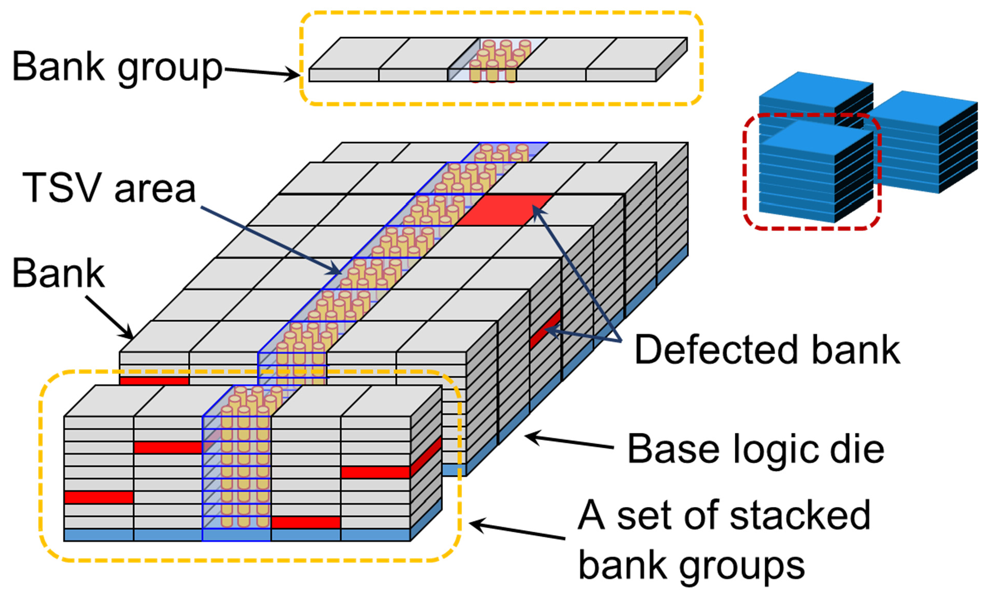
BBCube 3D redundancy – Typical Configuration of Stacked Synchronous DRAM Systems
This 2D redundancy was carried out on a die-by-die basis within each layer of the stack.
Recent DRAM devices were provided with extra cell arrays occupying 10% to 20% of the total area to reduce bit error rate (BER), in both cases of block sparing type redundancy and error check and correction (ECC)
When the 2D redundancy fail, the defective banks remain in the dies. In the case of the KGD process on the other hand, the dies were disposed of, which was in vain
With WOW technology, the calculated delay basis distance in the z-direction between neighboring layers was approxi- mately 30 µm.
It is possible to prefetch data from banks in different layers through the bypassing of vertical global wiring (Copper TSVs) in front of the buffer circuit block
Based upon the typical configuration

Slide 12
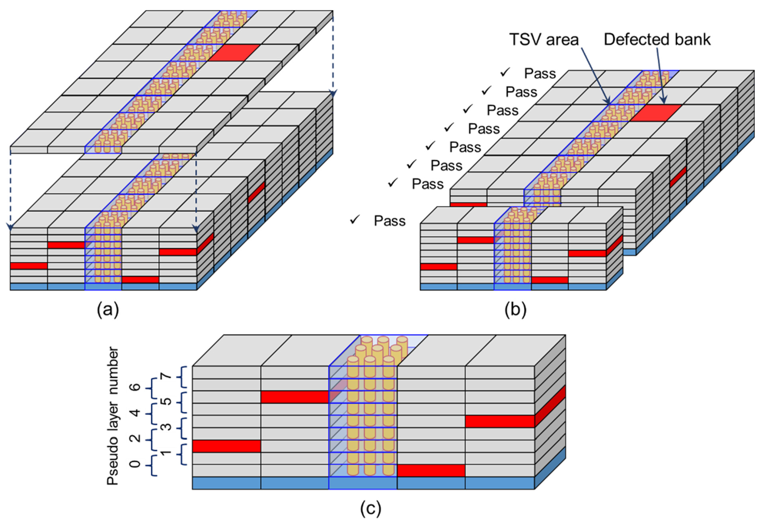
BBCube 3D redundancy –Techniques for 3D Redundancy
If defective banks result from the defect rate exceeding the 2D redundancy capability, the total number of non-defective banks is not enough for stack device operation.
To enable repair of such devices, we added an extra layer to supplement the required number of non-defective banks, which is illustrated in Figure (a).
Replacing defective banks within individual sets of stacked bank groups to provide the overall functionality of individual TSV “digits”.
The banks, which belong to TSV “digits” were grouped together as a bank group.
Basically, banks supported a closely located set of TSV “digits”, to avoid an increase in internal wiring capacitance Therefore, we were able to replace defective banks within individual sets of stacked bank groups to provide the overall functionality of individual TSV “digits”.
11.1.5. Quasi Layer-by-Layer Operation

Slide 13
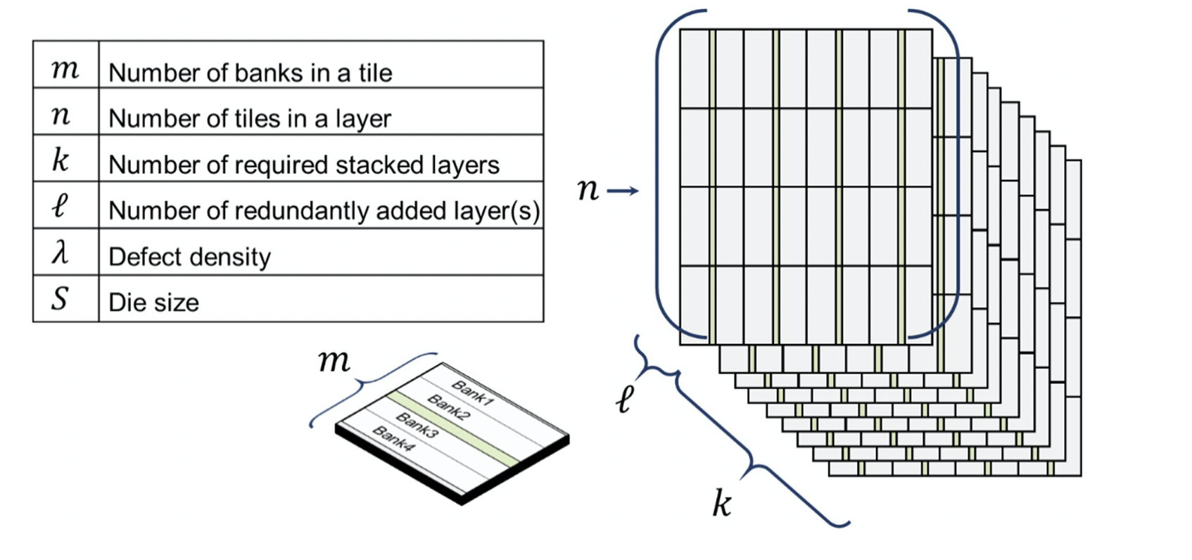
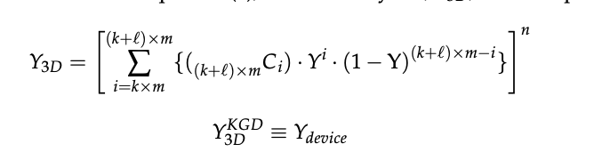
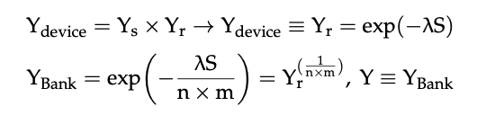
11.1.8. Yield Calculation
Ys is systematic yield, Yr is random defect yield, S is the die size, and λ represents the area density of random defects\

Slide 14
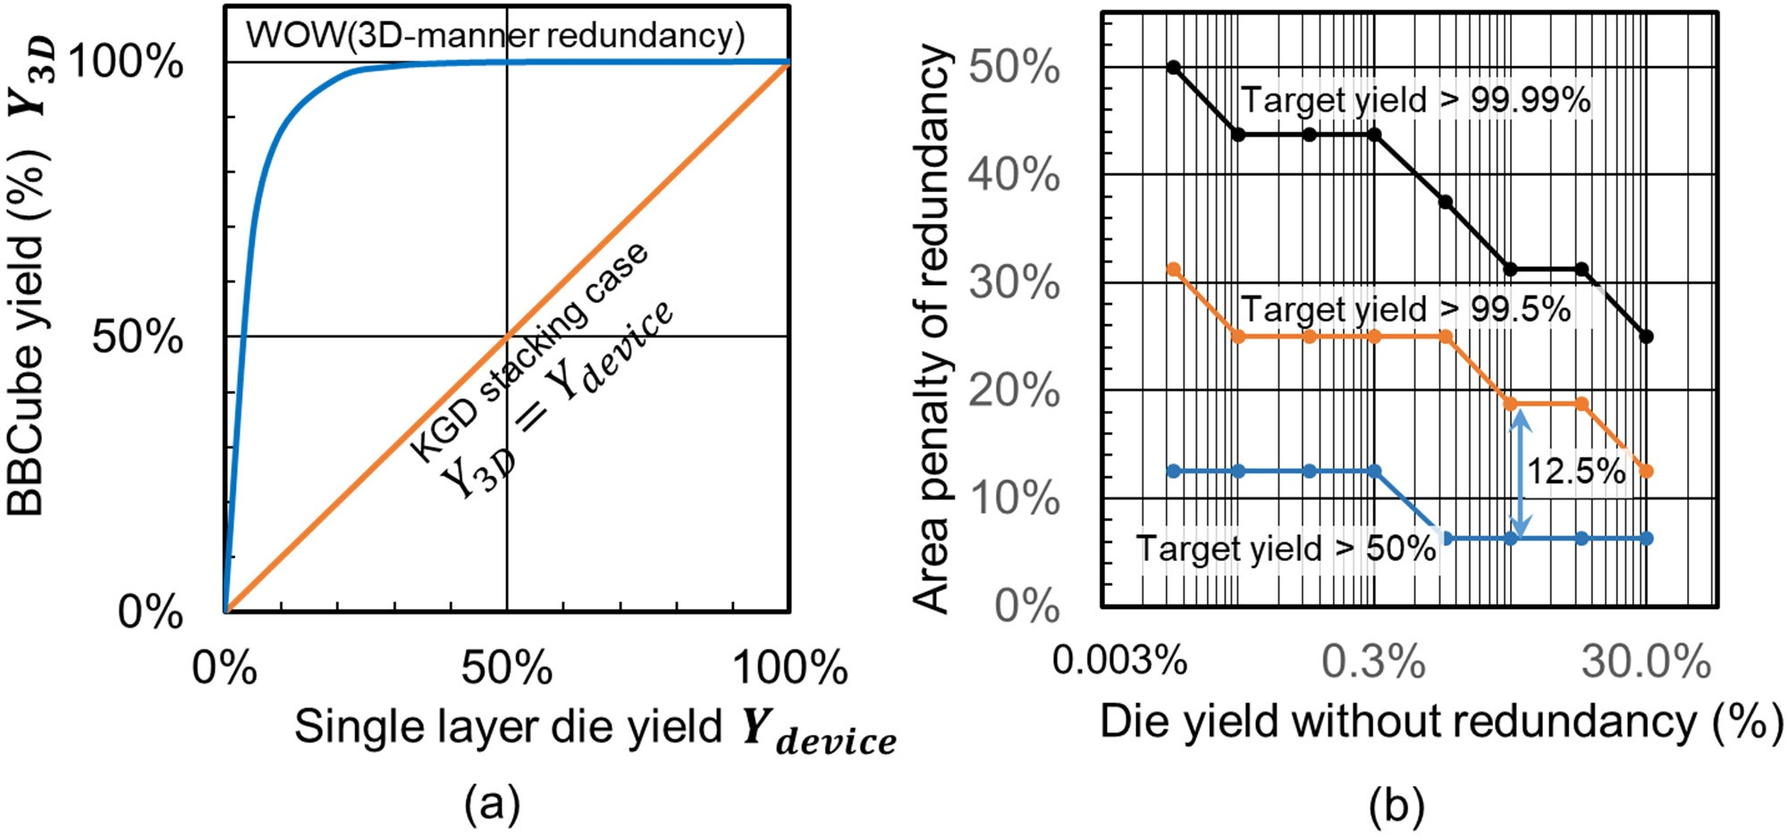
Results of BBCube Yield
As indicated in Figure 52a, BBCube fabricated by the WOW process showed better yield than that of the KGD stacking case, for all single layer die yields Ydevice.
The reason is as follows. For the KGD case, if the required number of banks is not available in a silicon die, the die area is wasted.
On the contrary, for the WOW case, when there is an error in banks, the necessary number of banks can be substituted from other layers in the stack of bank groups.
Therefore, when the single layer die yield Ydevice is greater than or equal to 50%, the BBCube yield becomes more than 99% with 3D redundancy. If we want to achieve such excellent yield with only 2D redundancy, we must prepare more redundant sub-arrays. The area penalty evaluation of 2D redundancy is shown in Figure 52b.

Slide 15
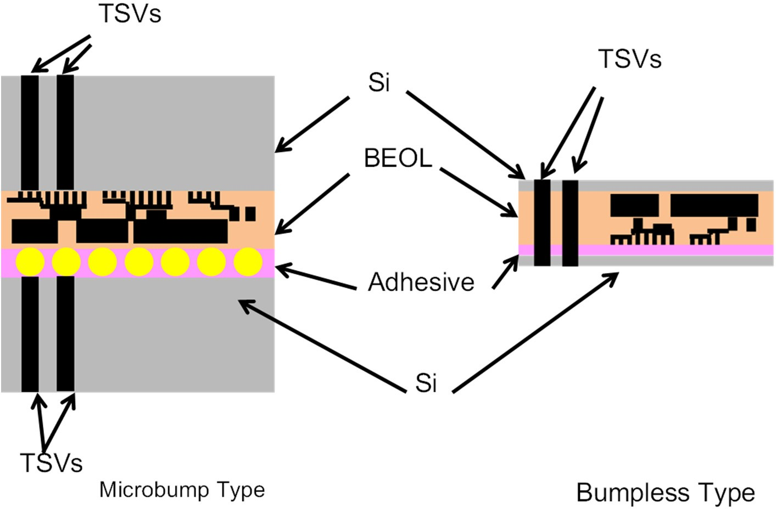
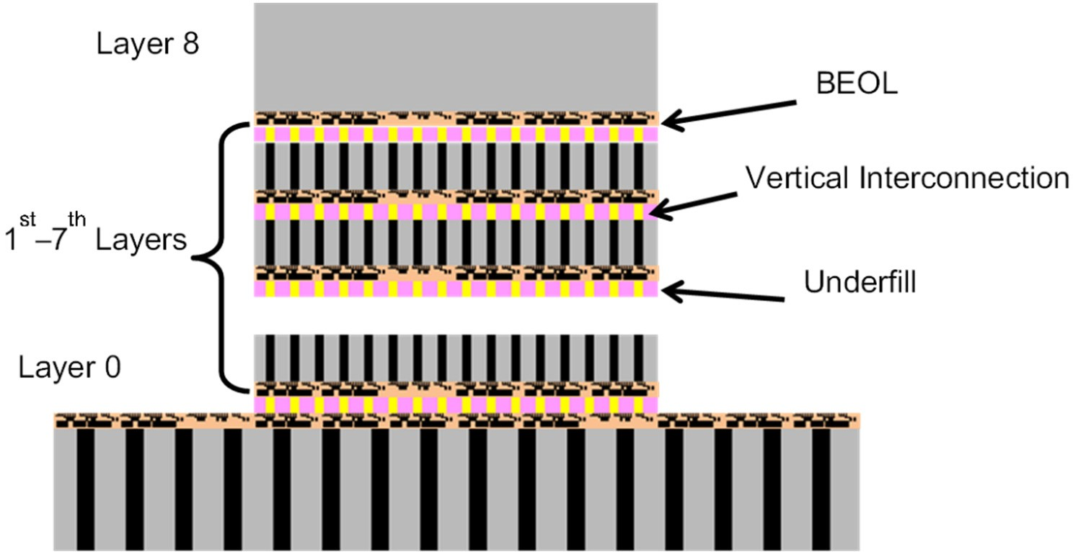
Thermal Resistance Calculation Method
Due to the vertical thermal resistance of interconnection layers and back end of line (BEOL) , the temperature of stacked dies increase when contain more IC chips.
A typical 3D stacked memory structure consists of base layer (layer 0) and memory dies (layer 1st to layer 8th). Each die has BEOL layer and vertical interconnect layer.
The temperature rise calculation had four primary steps
Make assumptions about the IC stack structure,
Estimate the effective thermal conductivity of each layer, and
Calculate thermal resistance of each layer, and
Calculate the temperature rise using the thermal network method.

Slide 16
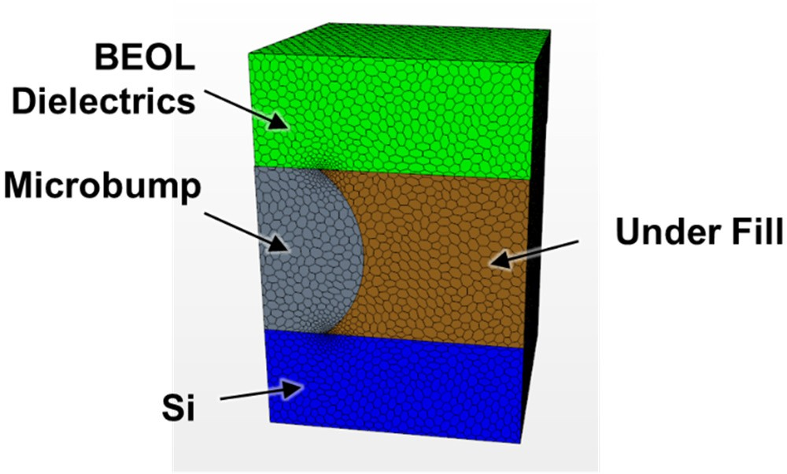
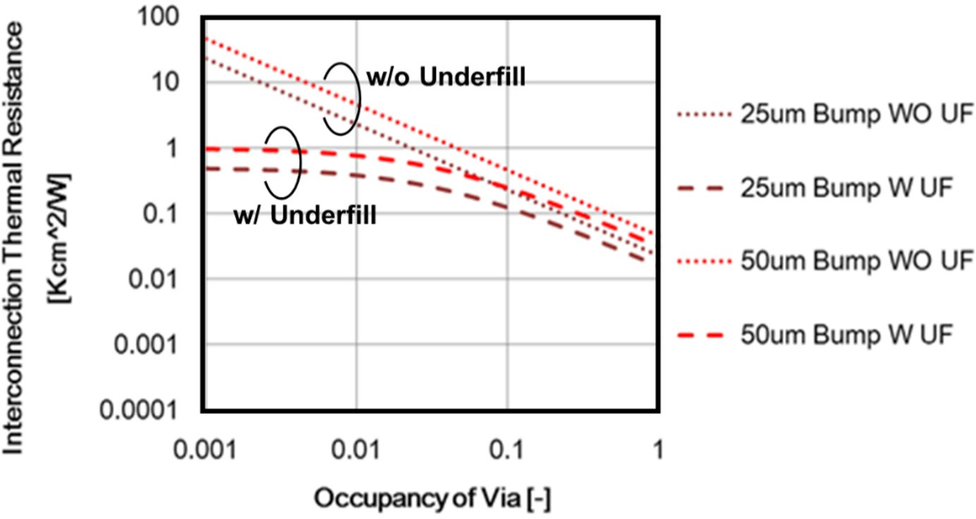
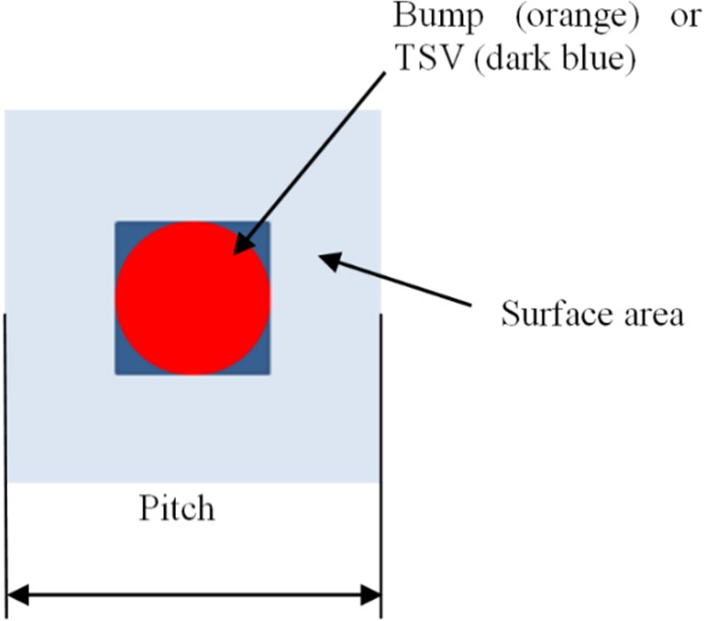
Thermal Resistance Comparison of BBCube and Micro-Bumps
The total thermal resistance of the micro-bump 3D stacked ICs can be calculated from calculated thermal conductivity of each layer.
The use of underfill material is advantageous only when the TSV occupancy (area of a bump of TSV / surface area) is less than 0.05.
Using these material thermal conductivities, the thermal resistance of each layer was calculated, and then the total thermal resistance was calculated.
The total thermal resistance was 1.54 Kcm2/W, which confirms that the thermal resistance of the BEOL and interconnection is too large to reduce the temperature rise.

Slide 17
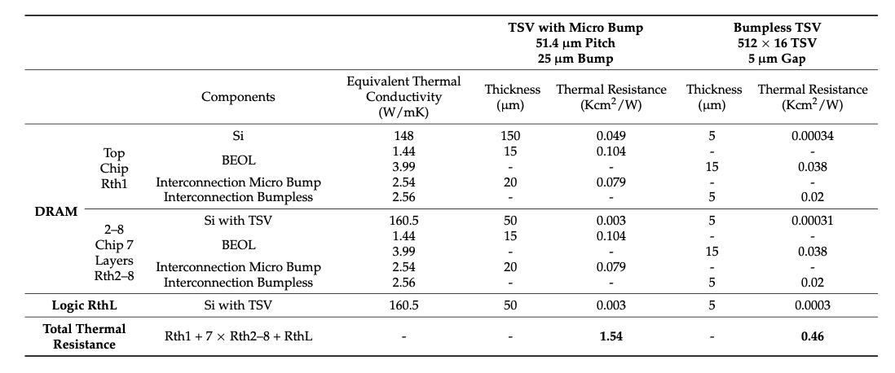
Thermal Resistance of BBC
Due to TSVs are formed by copper and thermal conductivity is around 400 (W/m/K) which is around 280 times and 160 times larger than BEOL and microbump interconnect.
The interconnection and BEOL thermal resistances for the bumpless type are also almost 4 and 3 times smaller.
The total thermal resistance of organic layers 20 and 5 µm thick were 1.54 and 0.46 Kcm2/W, respectively.
Total thermal resistance of TSV with microbump and bumpless TSV.
Notes:
Here shows the total thermal resisatance of TSV with microbump and bumpless TSV.
First, due to tsv are formed by copper and thermal conductivity is around 400 (W/m/K) which is around 280 times and 160 times larger than BEOL and microbump interconnect.
Here we can see due to the thiner thickness, the thermal resistance of bumpless tsv is much smaller than micro bump tsv.
And the place that is most likely to cause thermal resistance is BEOL and the interconnection.
Obviously, bumpless tsv could reduce the thermal resistance due to the thickness and better equivalent thermal conductivity.
Ttotal thermal resistance of organic layers 20 and 5 µm thick were 1.54 and 0.46 Kcm2/W, respectively.

Slide 18
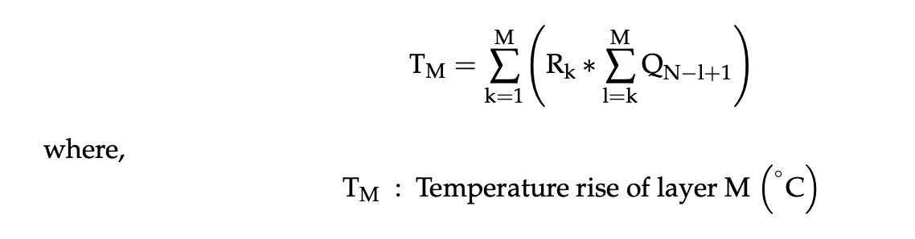
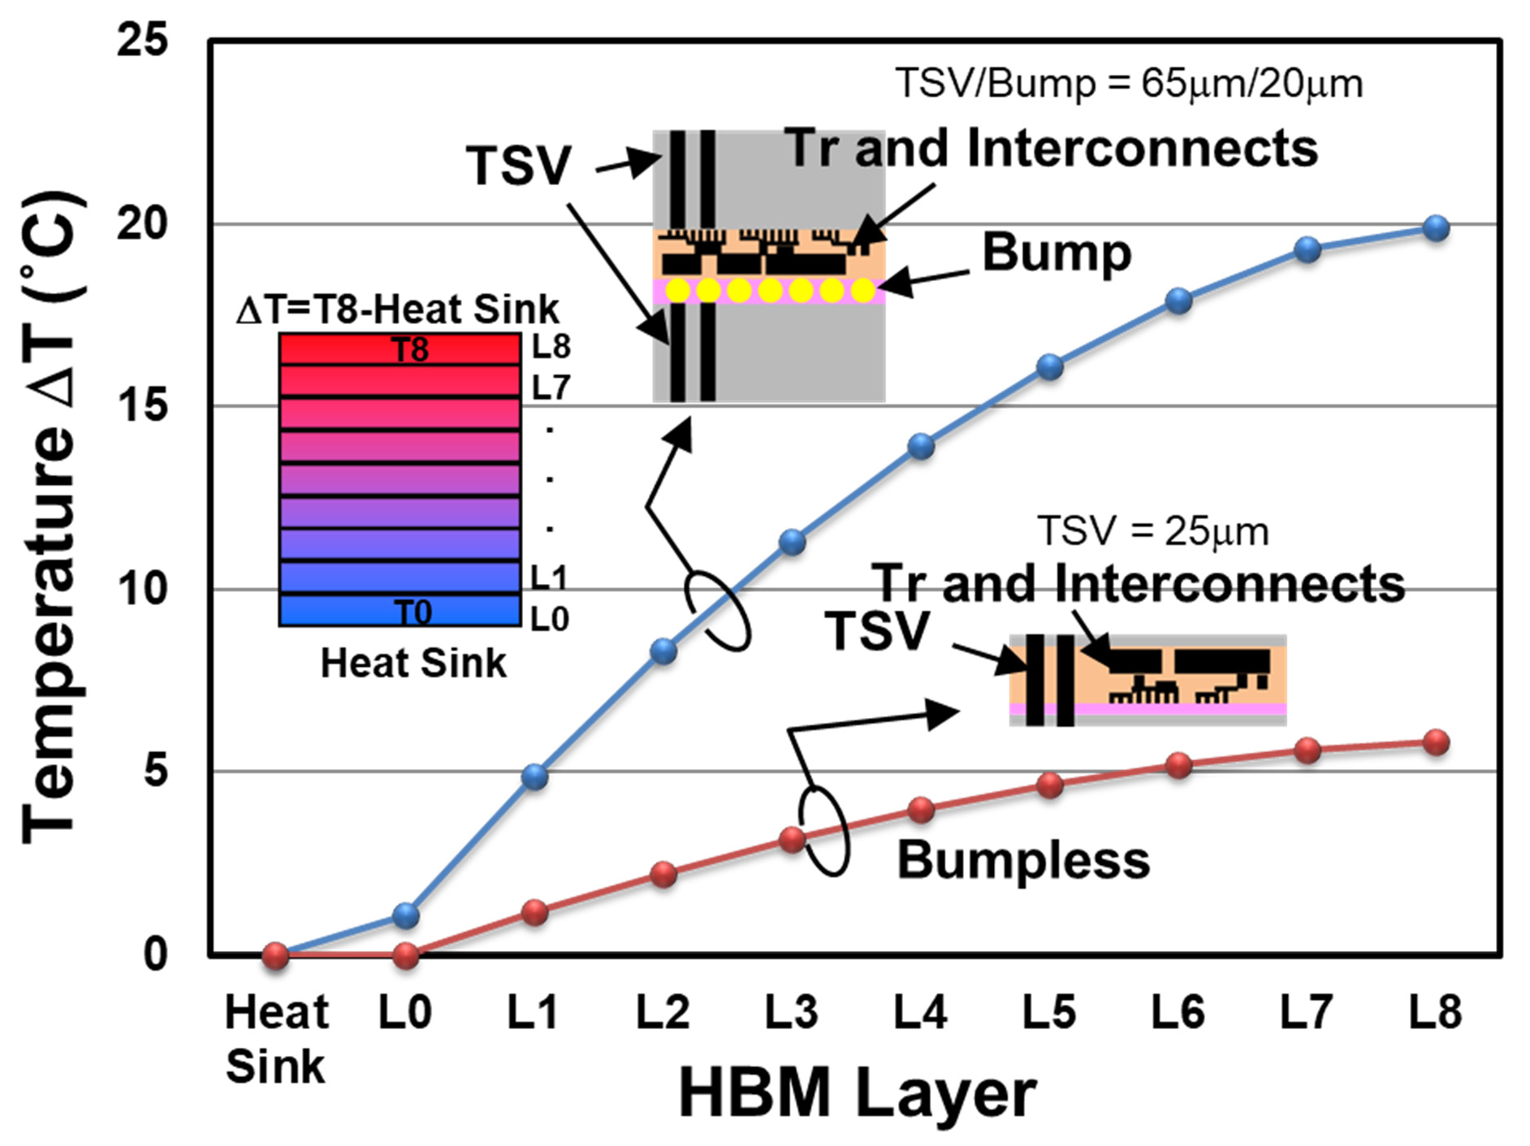
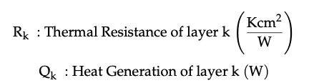
Thermal Resistance Comparison of BBCube and Micro-Bumps
The temperature rise for each layer was calculated using
The maximum temperature rise ∆T for the no microbump case (BBCube) was around 5.8 ◦C, which is almost one-fourth that of the microbump case.

Slide 19
Summary and Conclusion
Increasing the TSV interconnects density enables terabyte-level bandwidth without sacrificing energy efficiency.
Tapplication of 3D redundancy to utilize wafer form manufacturing have been presented and Wafer-on-wafer fabrication was realized with the support of a 3D redundancy scheme, which means that BBCube could be the next system scaling enabler.
This paper describes the process platform for BBCube WOW and COW technologies and BBCube DRAMs with high speed and low IO buffer power by enhancing parallelism
Increasing yield by using a vertically replaceable memory block architecture.
Present a comparison of thermal characteristics in 3D structures constructed with micro-bumps and BBCube the total thermal resistance of organic layers 20 and 5 µm thick were 1.54 and 0.46 Kcm2/W, respectively.

